Slide 1
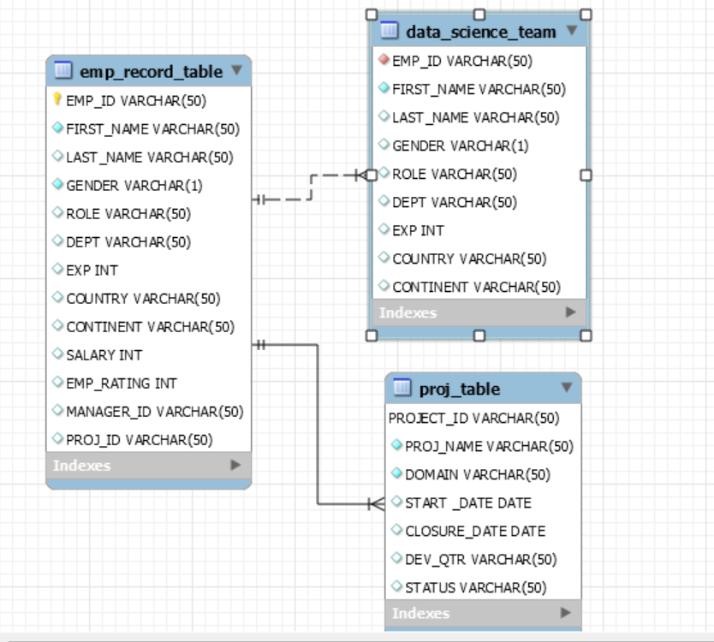
Create a database named employee, then import data_science_team.csv proj_table.csv and emp_record_table.csv into the employee database from the given resources.
CREATE DATABASE IF NOT EXISTS employee; Use employee;
Create an ER diagram for the given employee database.

Slide 2
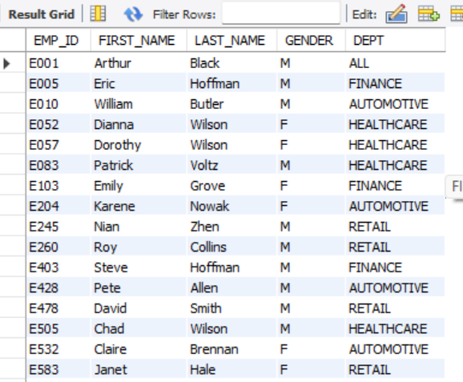
Write a query to fetch EMP_ID, FIRST_NAME, LAST_NAME, GENDER, and DEPARTMENT from the employee record table, and make a list of employees and details of their department.
select EMP_ID, FIRST_NAME, LAST_NAME, GENDER, DEPT
FROM employee.emp_record_table;

Slide 3
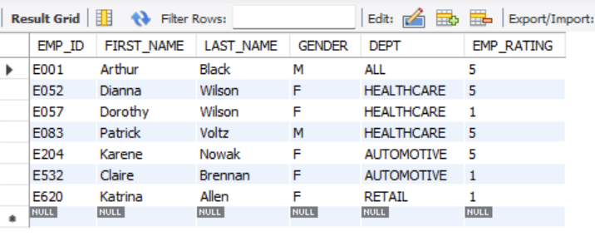
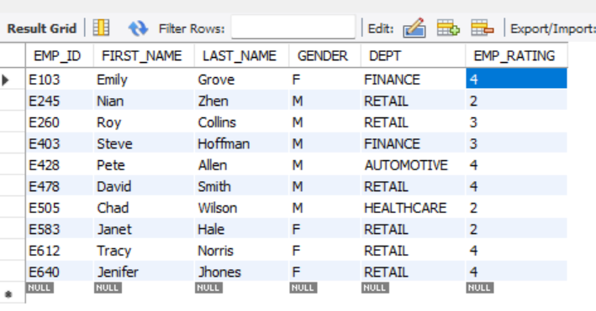
Write a query to fetch EMP_ID, FIRST_NAME, LAST_NAME, GENDER, DEPARTMENT, and EMP_RATING if the EMP_RATING is: less than two greater than four between two and four
Select EMP_ID, FIRST_NAME, LAST_NAME, GENDER, DEPT,EMP_RATINGFROM employee.emp_record_table where EMP_RATING <2 or EMP_RATING >4;
Select EMP_ID, FIRST_NAME, LAST_NAME, GENDER, DEPT,EMP_RATINGFROM employee.emp_record_tablewhere EMP_RATING between 2 and 4;

Slide 4
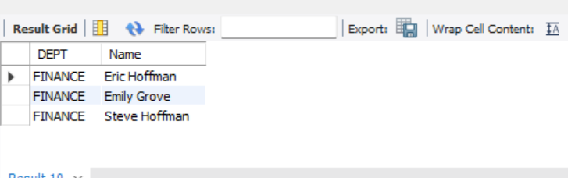
Write a query to concatenate the FIRST_NAME and the LAST_NAME of employees in the Finance department from the employee table and then give the resultant column alias as NAME.
SELECT DEPT, concat(First_name ,' ', Last_name) as Name FROM employee.emp_record_table where Dept = 'Finance';

Slide 5
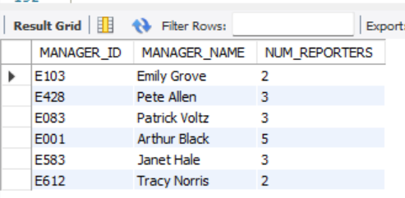
Write a query to list only those employees who have someone reporting to them. Also, show the number of reporters (including the President).
SELECT e2.Emp_ID AS ManagerID, concat(e2.First_name,'',e2.Last_name) AS Manager ,count(e2.Emp_ID)FROM employee.emp_record_table AS e1 JOIN employee.emp_record_table AS e2 ON e1.Manager_ID = e2.Emp_ID
Group by e2.Emp_ID;

Slide 6
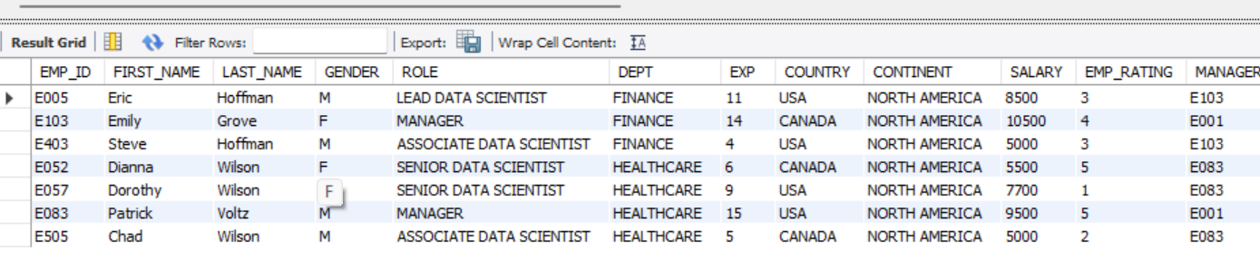
Write a query to list down all the employees from the healthcare and finance departments using union. Take data from the employee record table.
SELECT * FROM employee.emp_record_table WHERE dept = 'FINANCE’ UNION SELECT * FROM employee.emp_record_table WHERE dept = 'HEALTHCARE'

Slide 7
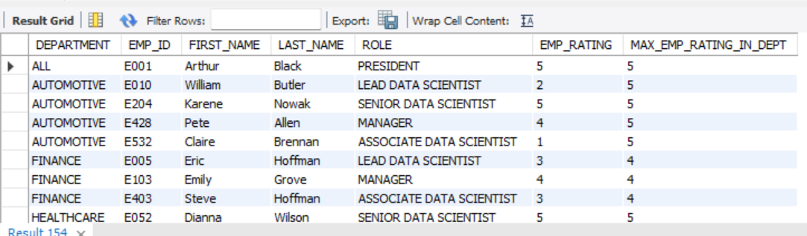
Write a query to list down employee details such as EMP_ID, FIRST_NAME, LAST_NAME, ROLE, DEPARTMENT, and EMP_RATING grouped by dept. Also include the respective employee rating along with the max emp rating for the department.
SELECT E.DEPT AS DEPARTMENT, E.EMP_ID, E.FIRST_NAME, E.LAST_NAME, E.ROLE, E.EMP_RATING, MAX(E.EMP_RATING) OVER (PARTITION BY E.DEPT) AS MAX_EMP_RATING_IN_DEPT FROM emp_record_table E;

Slide 8
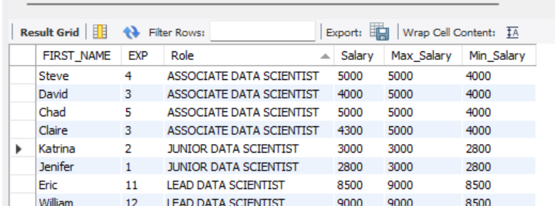
Write a query to calculate the minimum and the maximum salary of the employees in each role. Take data from the employee record table.
SELECT FIRST_NAME ,EXP,Role,Salary,max(Salary) over(partition by Role) as Max_Salary, min(Salary) over(partition by Role) as Min_Salary FROM employee.emp_record_table;

Slide 9
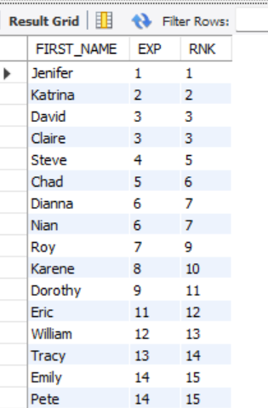
Write a query to assign ranks to each employee based on their experience. Take data from the employee record table.
SELECT FIRST_NAME ,EXP, rank() over (order by EXP) As RNK FROM employee.emp_record_table;

Slide 10
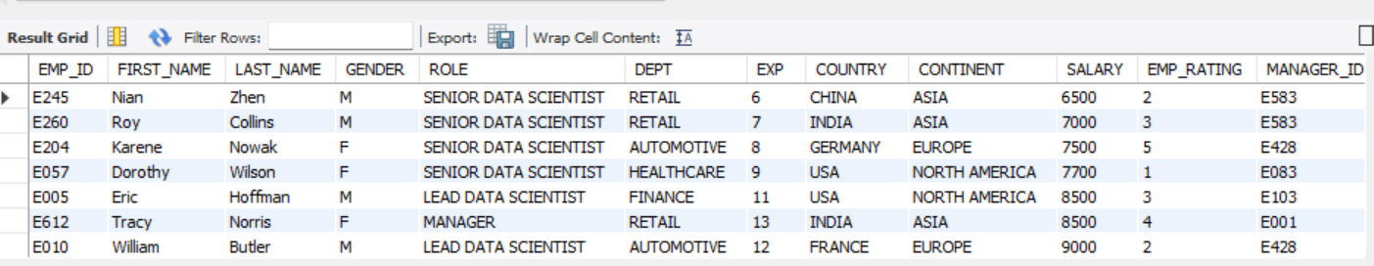
Write a query to create a view that displays employees in various countries whose salary is more than six thousand. Take data from the employee record table
create view Empsalary as SELECT * FROM employee.emp_record_table where SALARY > 6000 ; select * from Empsalary;

Slide 11
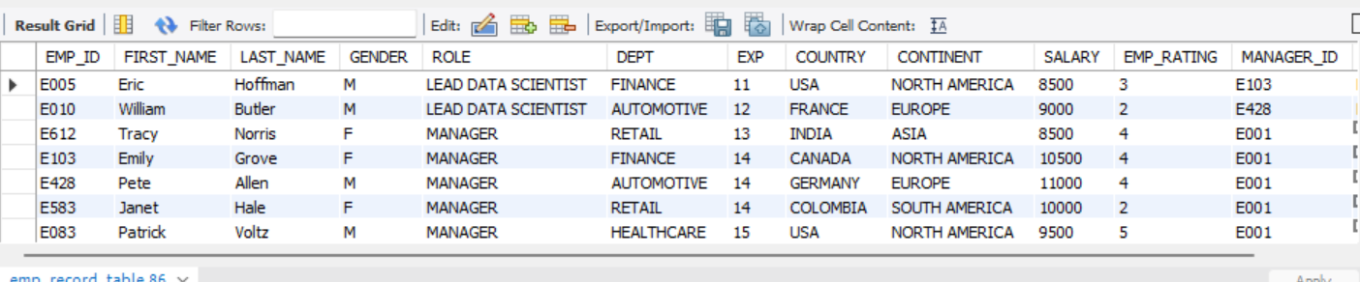
Write a nested query to find employees with experience of more than ten years. Take data from the employee record table.
SELECT * FROM employee.emp_record_table where EMP_ID IN ( SELECT EMP_ID FROM employee.emp_record_table where EXP >10) ;

Slide 12
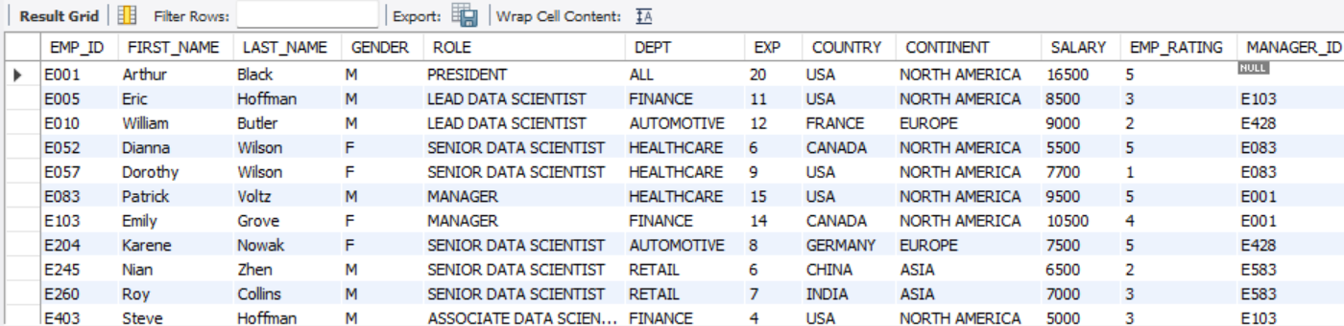
Write a query to create a stored procedure to retrieve the details of the employees whose experience is more than three years. Take data from the employee record table.
Drop procedure if exists Emp_exp; Delimiter $$ create procedure Emp_exp() Begin select* FROM employee.emp_record_table where exp > 3 ; End $$ call Emp_exp();

Slide 13
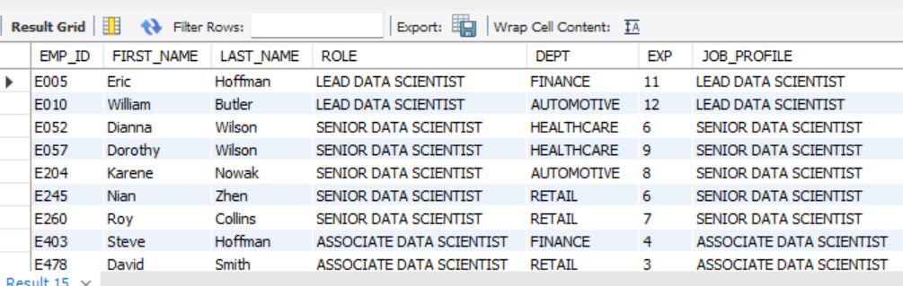
Write a query using stored functions in the project table to check whether the job profile assigned to each employee in the data science team matches the organization’s set standard.
DELIMITER // CREATE FUNCTION GetJobProfile(experience INT) RETURNS VARCHAR(255) DETERMINISTIC BEGIN DECLARE jobProfile VARCHAR(255); IF experience <= 2 THEN SET jobProfile = 'JUNIOR DATA SCIENTIST’; ELSEIF experience <= 5 THEN SET jobProfile = 'ASSOCIATE DATA SCIENTIST’; ELSEIF experience <= 10 THEN SET jobProfile = 'SENIOR DATA SCIENTIST’; ELSEIF experience <= 12 THEN SET jobProfile = 'LEAD DATA SCIENTIST’; ELSE SET jobProfile = 'MANAGER'; END IF; RETURN jobProfile; END // DELIMITER ; SELECT EMP_ID, FIRST_NAME, LAST_NAME, ROLE, DEPT, EXP, GetJobProfile(EXP) AS JOB_PROFILE FROM Data_science_team;

Slide 14
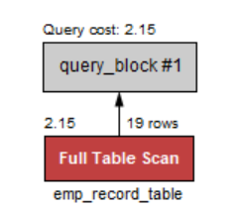
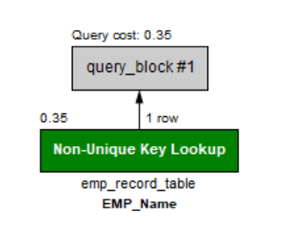
Create an index to improve the cost and performance of the query to find the employee whose FIRST_NAME is ‘Eric’ in the employee table after checking the execution plan.
create index EMP_Name on employee.emp_record_table(First_Name);
SELECT * FROM employee.emp_record_table where FIRST_NAME ='Eric';

Slide 15
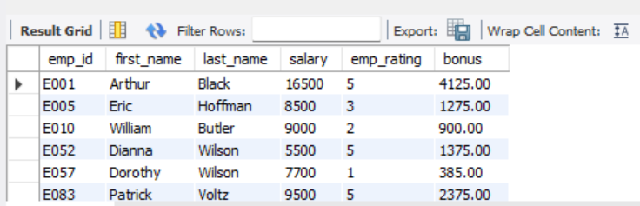
Write a query to calculate the bonus for all the employees, based on their ratings and salaries (Use the formula: 5% of salary * employee rating).
SELECT emp_id, first_name, last_name, salary, emp_rating, ROUND((((5.0/100) * salary) * emp_rating), 2) AS bonusFROM employee.emp_record_table;

Slide 16
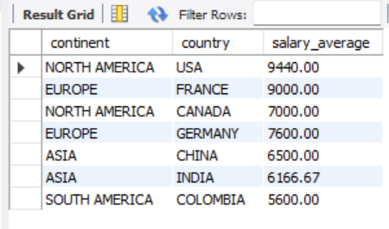
Write a query to calculate the average salary distribution based on the continent and country. Take data from the employee record table.
SELECT continent,country, ROUND(AVG(salary),2) AS salary_average FROM employee.emp_record_table GROUP BY continent, country;

